Slide 1
Intelligent Chat-bot
Presented by: Juveriya Zameer

Slide 2
Problem Formulation
Create
Create an Ontology
Make
Make competency questions and train the agent
Create
Create test cases and test the agent

Slide 3

Ontology
The ontology is developed by using the tool Protégé.
The basis material for our ontology is EBC5125 : DSA course class lectures.
The steps involved in the creation of the ontology are:
Selecting a domain
01
Defining the classes and their hierarchy
02
Defining the properties of the classes and creating the instances
03

Slide 4
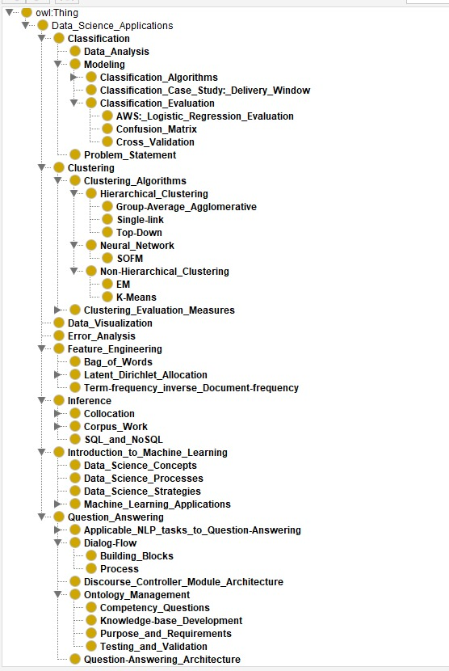
Ontology

Slide 5
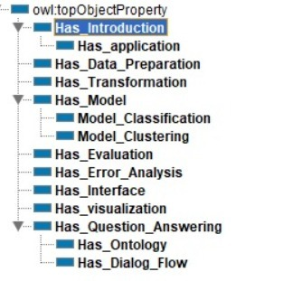
Object Properties

Slide 6
Competency Questions
A question list of six.
Some examples of competency questions that we developed:
i) What is Data Science?
ii) What are the applications of Data Science?
iii) What is Feature engineering in the context of Data Science?
Etc.

Slide 7
Training Chat-bot agent
Chat-bot implemented using Dialog Flow
Trained the agent on the basis of the competency questions and tested it with the test cases.

Slide 8
Test Cases
To check the quality and performance of the chat-bot agent I have made test cases every competency question. These test cases can be used to test the chat-bot agent after it is trained with the training phrases.
Some examples of test case questions are:
Competency Question: What is Data Science?
-What do you mean by Data Science?
-Define Data Science.
-What is data science in simple words?
-Describe what’s Data Science?
-How do you define data science?
-What is data science for beginners?

Slide 9
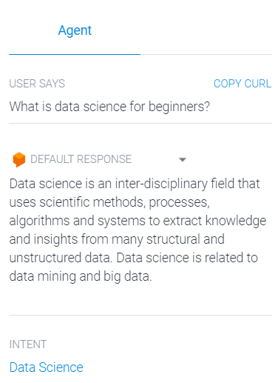
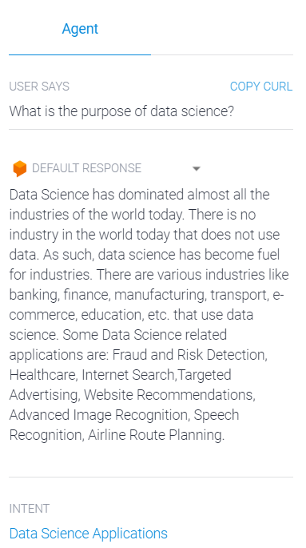
Evaluating the Chat-bot
Competency Question: What is Data Science?
Test Case1: What is data science for beginners? Test Case 2: What is the purpose of data science?

Slide 10
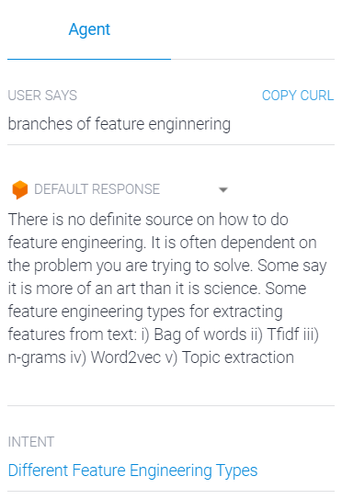
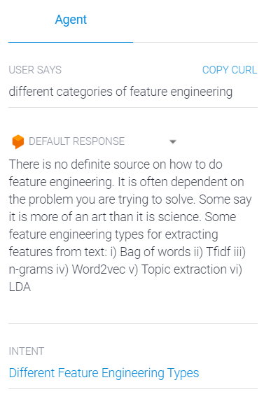
Evaluating the Chat-bot
Competency Question: What are the different types of feature engineering?
Test Case1: Branches of Feature Engineering. Test Case 2: Different categories of feature engineering

Slide 11
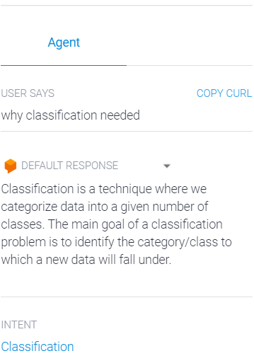
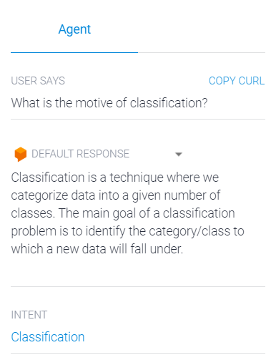
Evaluating the Chat-bot
Competency Question: What is classification in the context of data science?
Test Case1: Why is classification needed? Test Case 2: What is the motive of classification?

Slide 12
Conclusion
Protégé gives a clear view about the classes, subclasses and the hierarchy which is required for creating a chat-bot
Using Protege, created a skeleton for the chat-bot.
The competency questions has helped to create an exact intent in the chat-bot with the right set of training phrases.
A set of well-defined training phrases has given the required output for various questions.
I have verified whether the chat-bot gives the right output for a particular question or multiple questions with the same meaning using the test cases that we created for every intent we made in the chat-bot.

